Slide 1












The issue
Relevance
Team
The solution
Development Highlighs
Arquitecture
Goals
Metodology
Closing

Slide 2





Jorge Palma
Scrum Master
Team
Eduardo Fariña
Developer
Luis Vera
UI/UX Designer

Slide 3



The issue
Fear of becoming obsolete
Key info fragmentation
Lack of clear learning paths

Slide 4


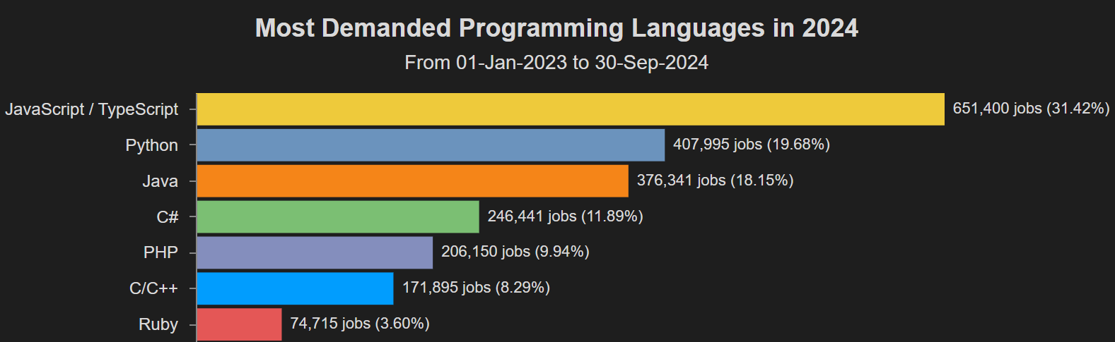
The solution
Nexus as a integral platform
Resource variety
Collaborative Comunity
Javascript as the foundation
Notes:
Solución

Slide 5
Relevance
Added value for institutions and companies
Information Overflow
Productivity and working quality

Slide 6

News and courses platform
Selt-teaching focused
Goals
Community builded

Slide 7

¿Why Scrum?
Flexibility to changes
Spr
Incremental and Iterative nature
Constant feedback
Resource management
Metodology

Slide 8
Development highlights
1.- Project choosing/tools
2.- Requirement Analysis
3.- Mockup/Data modeling
4.- Development environment Setup
5.- Static front-end
Notes:
Caso de Uso: ANA

Slide 9

Development highlights
6.- Starting controllers development
7.- News and courses CRUD
8.- Dynamic front-end components
9.- User testing
10.- Documentation
Notes:
Caso de Uso: ANA

Slide 10

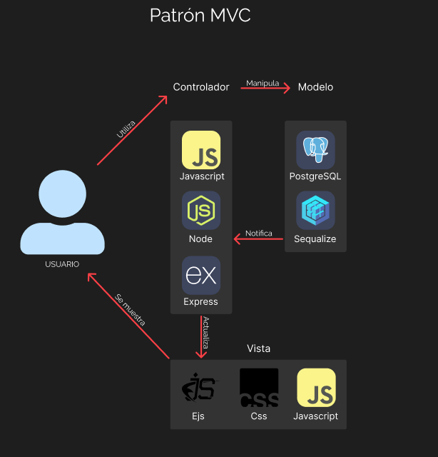
Software’s
Architecture

Slide 11
Use case
https://www.youtube.com/watch?v=KnM2g5mqQFw

Slide 12

Closing words

